Slide 1
STEPS TO BECOME “DevOps” ENGINEER
An operating system (OS) is a program that allows you to interact with the computer -- all of the software and hardware on your computer.
Prerequisites
Operating system (os):
Linux
Unix
windows

Slide 2
Three types of cloud platforms:
The three leading cloud computing vendors, AWS, Microsoft Azure and Google Cloud, each have their own strengths and weaknesses that make them ideal for different use cases.
Amazon web services (2006)
Microsoft azure (2010)
G00gle cloud platform (2011)

Slide 3
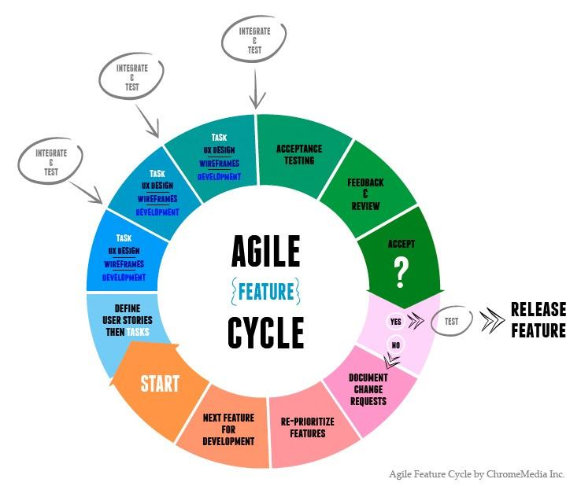
SDLC AND AGILE METHOD The waterfall model is a sequential design process in which progress is seen as flowing steadily downwards (like a waterfall) through the phases of Conception, Initiation, Analysis, Design, Construction, Testing, Production/Implementation and Maintenance.

Slide 4
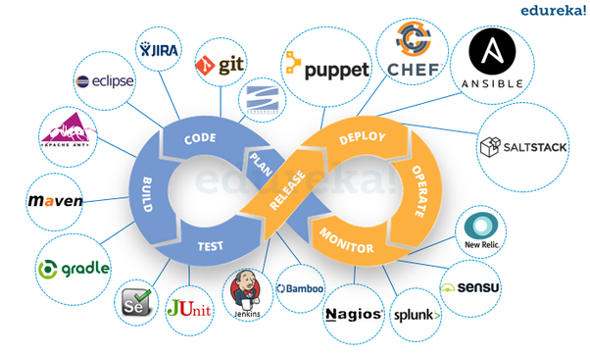
DevOps
DevOps (development and operations) is an enterprise software development phrase used to mean a type of agile relationship between development and IT operations. The goal of DevOps is to change and improve the relationship by advocating better communication and collaboration between these two business units.

Slide 5
Tools which we cover
GIT & GITHUB : source code management tool .
MAVEN : Project build tool.
SONARQUBE : code quality tool.
NEXUS : Binary repository manager
JENKINS : CI & CD
DOCKER & VAGRANT: container tool for deploying
PUPPET, CHEF, & ANSIBLE: configuration management tool
NAGIOS : monitoring and alerting services for servers.

Slide 6
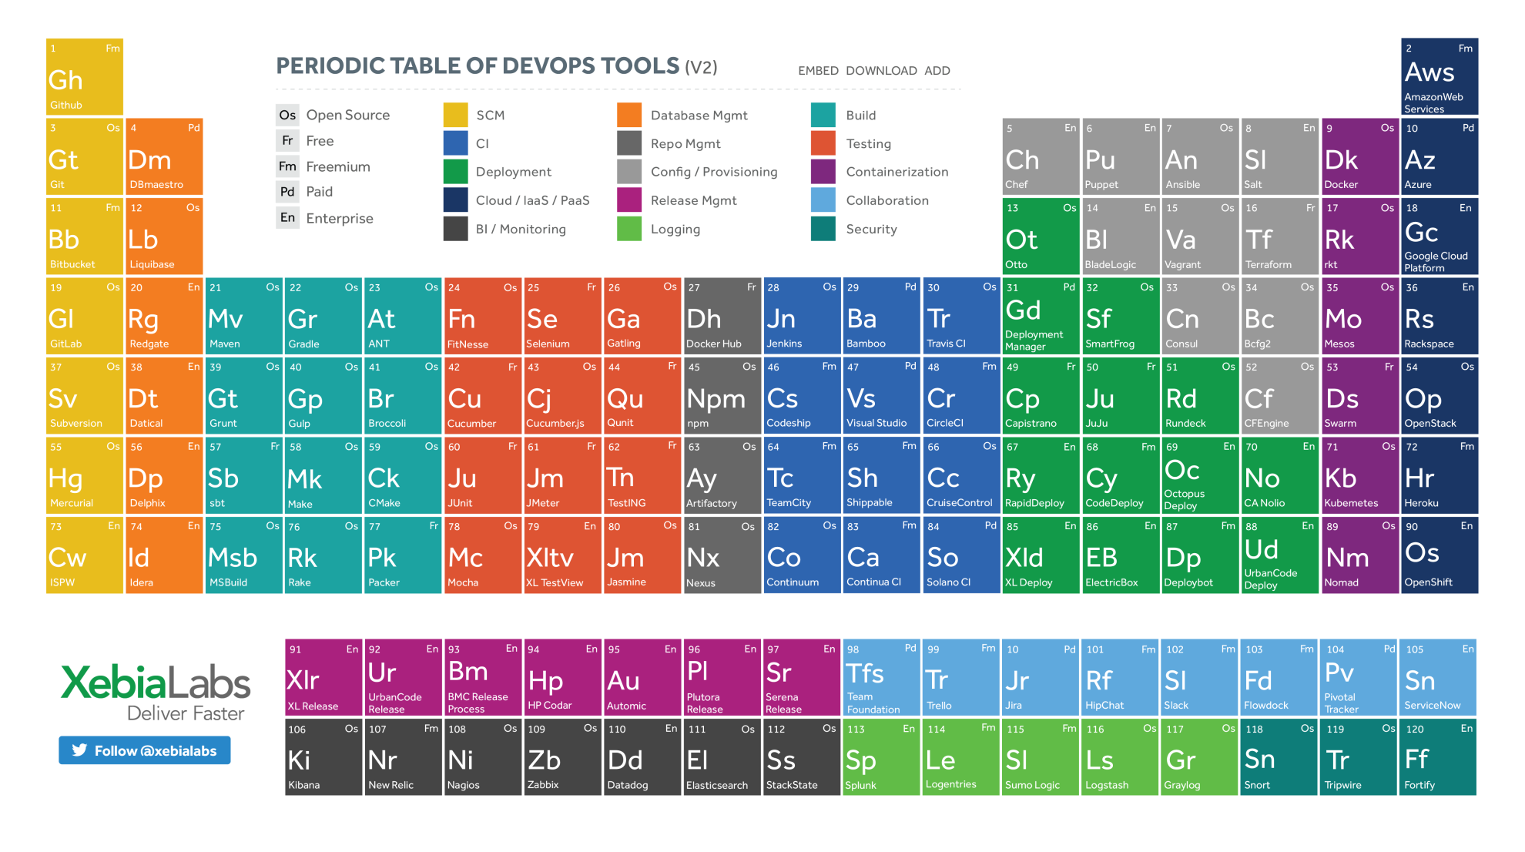
DevOps periodic table

Slide 7
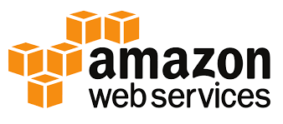
Amazon web services
Amazon web services (AWS) is a comprehensive, evolving cloud computing platform provided by Amazon. It provides a mix of infrastructure as a service (IaaS), platform as a service (PaaS) and packaged software as a service (SaaS) offerings.
USE OF AWS: Amazon Web Services (AWS) is a secure cloud services platform, offering compute power, database storage, content delivery and other functionality to help businesses scale and grow.

Slide 8
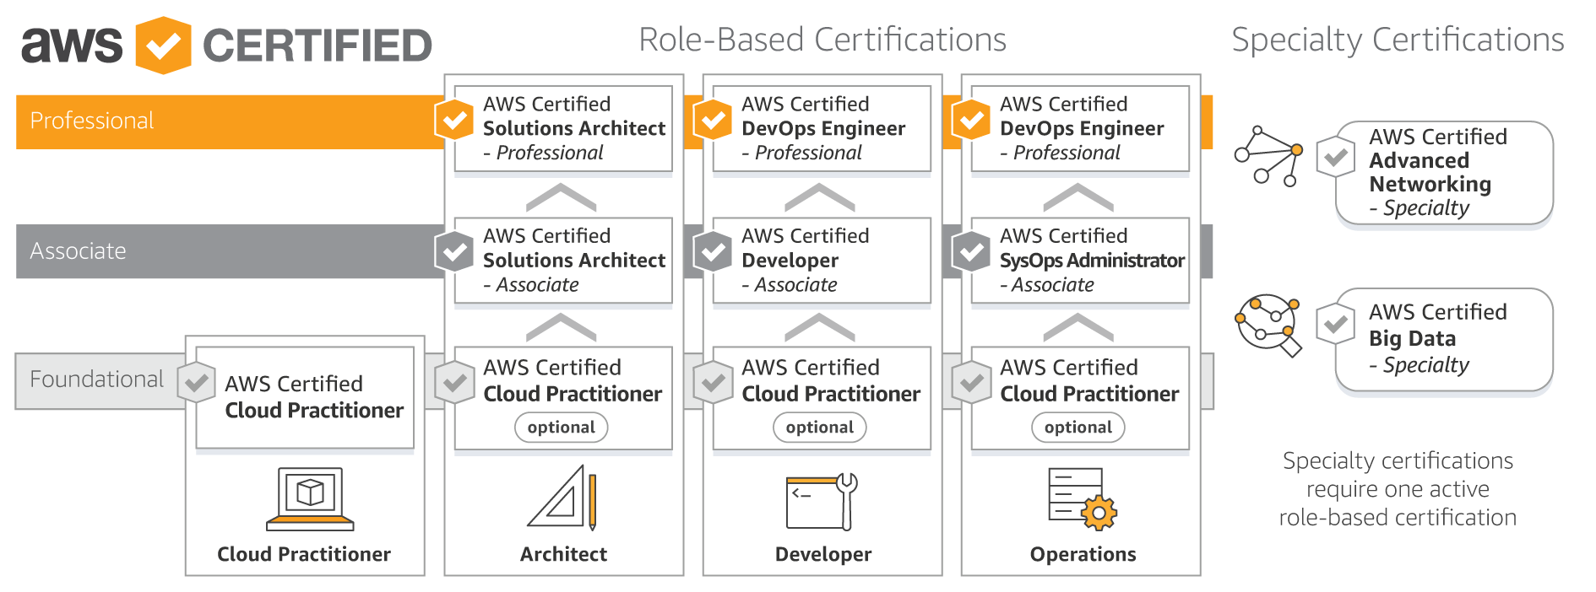
AWS Role-based certifications

